Slide 1
AI Fundamentals
Madison College
Week 02
Part 2: Machine Learning techniques - Neural Networks and Natural Language Processing

Slide 2
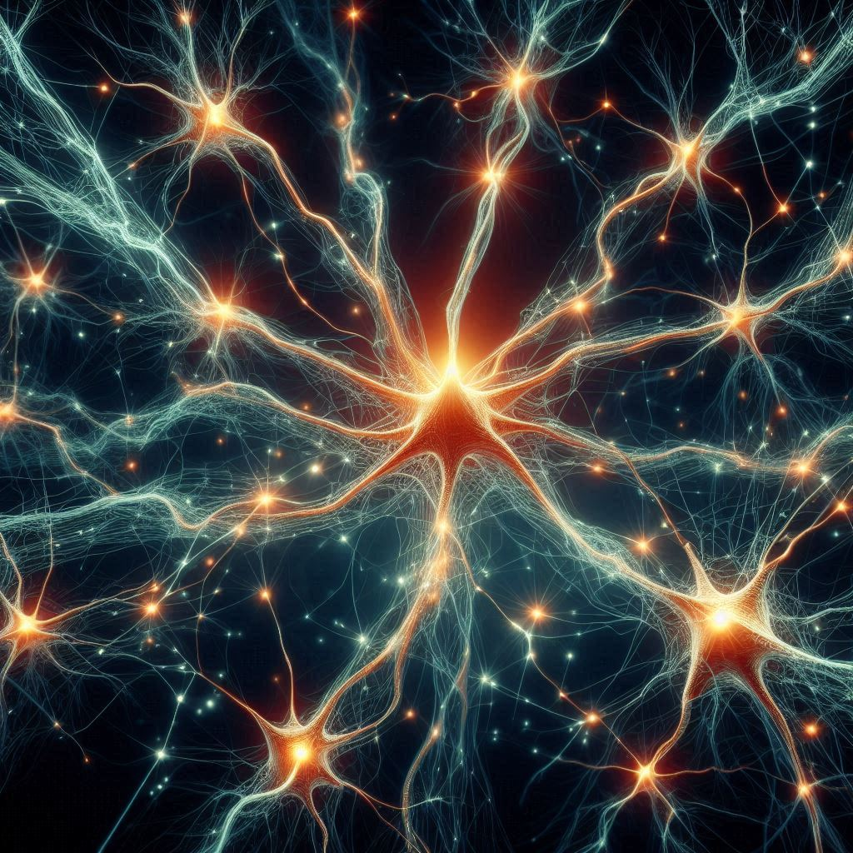
Neural Networks
A neural network is a type of machine learning model that draws inspiration from the structure and function of a brain
The network is composed of interconnected "artificial neurons" that work together to process and learn from data
The modern advances in generative AI all have a common foundation in neural networks
Notes:
Coplilot Designer, 05312024; “a network of neurons firing with visible electrical inpulses”

Slide 3
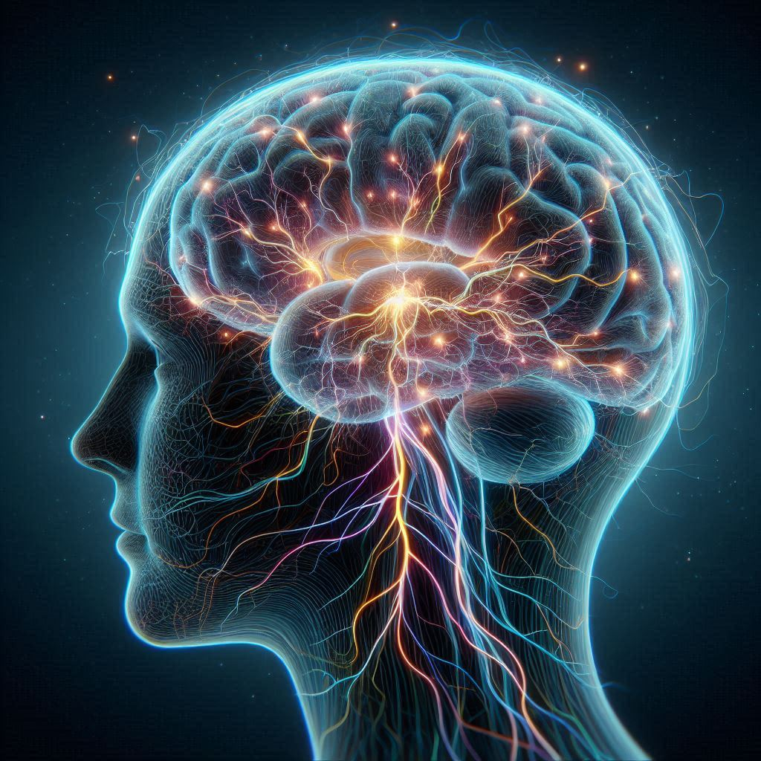
Brain Structure
Neurons are specialized cells in the brains of animal life which pass messages to each other through neurotransmission
The messages influence whether a particular neuron will fire which in turn sends out new messages across synapses connecting the cells
Some neurons transmit chemical messages while other neurons use electrical transmission where ions transfer directly between the neurons
Notes:
Neurons are specialized cells in the brains of animal life. The neurons will pass messages to each other through neurotransmission. The messages influence whether a particular neuron will fire which in turn sends out new messages. The messages pass across structures called synapses between the neurons. Some neurons will transmit chemical messages while other neurons will use electrical transmission where ions transfer directly between the neurons across the synapse. As one or more neurons decide to fire, they send messages to other neurons, who then, in turn, send messages out until the process completes.
Copilot Designer, 05312024; “image of a human brain with visible electrical arcs”

Slide 4
Neural Network basics
Computer neural networks may take on some characteristics of a cluster of neurons, but the similarity is only superficial
Neural networks are made up of multiple layers of interconnected nodes that can learn to perform tasks by analyzing examples, without being explicitly programmed
Each node has a numerical value assigned to it and is thought of as a neuron
Networks are composed of multiple node layers: Input, Hidden, Output
I
H
O
Notes:
Computer neural networks may take on some characteristics of a cluster of neurons, but the similarity is only superficial. Neural networks are made up of multiple layers of interconnected nodes that can learn to perform tasks by analyzing examples, without being explicitly programmed. Each node is thought of as a neuron. The node has a numerical value assigned to it.

Slide 5
Neural Network construction
Input Layer nodes receive numerical data (typically) for processing by the Network; these nodes values are supplied in order to recall a previously remembered value
Notes:
Input Layer nodes receive numerical for processing by the Network
Hidden Layer nodes are intermediate nodes between the Input and Output layers
Output Layer nodes are the resulting values after the input nodes are processed
Weights connect the Nodes forming a web of interconnections. In this way, each Node in a Layer is connected to every other Node in the next subsequent Layer. Each connection is called a Weight and has a numerical value associated with it. Weights are modified, as with the Node values, to strengthen pathways for the successful recall of information. Weights are established through Training.

Slide 6
Neural Network construction, cont’d
Input Layer nodes receive data for processing by the Network
Hidden Layer nodes are intermediate nodes between the Input and Output layers; these nodes forms the engine of the network and are instrumental to the performance of the network
Notes:
Input Layer nodes receive numerical for processing by the Network
Hidden Layer nodes are intermediate nodes between the Input and Output layers
Output Layer nodes are the resulting values after the input nodes are processed
Weights connect the Nodes forming a web of interconnections. In this way, each Node in a Layer is connected to every other Node in the next subsequent Layer. Each connection is called a Weight and has a numerical value associated with it. Weights are modified, as with the Node values, to strengthen pathways for the successful recall of information. Weights are established through Training.

Slide 7
Neural Network construction, cont’d
Input Layer nodes receive data for processing by the Network
Hidden Layer nodes are between the Input and Output layers
Output Layer nodes contain the resulting values after the input nodes are processed; these contain the “recalled” memory from the Network
Notes:
Input Layer nodes receive numerical for processing by the Network
Hidden Layer nodes are intermediate nodes between the Input and Output layers
Output Layer nodes are the resulting values after the input nodes are processed
Weights connect the Nodes forming a web of interconnections. In this way, each Node in a Layer is connected to every other Node in the next subsequent Layer. Each connection is called a Weight and has a numerical value associated with it. Weights are modified, as with the Node values, to strengthen pathways for the successful recall of information. Weights are established through Training.

Slide 8
Neural Network construction, cont’d
Input Layer nodes receive data for processing by the Network
Hidden Layer nodes are between the Input and Output layers
Output Layer nodes contain the resulting values
Numerical weights connect the Nodes where each Node in a Layer is connected to every other Node in the next subsequent Layer
Notes:
Input Layer nodes receive numerical for processing by the Network
Hidden Layer nodes are intermediate nodes between the Input and Output layers
Output Layer nodes are the resulting values after the input nodes are processed
Weights connect the Nodes forming a web of interconnections. In this way, each Node in a Layer is connected to every other Node in the next subsequent Layer. Each connection is called a Weight and has a numerical value associated with it. Weights are modified, as with the Node values, to strengthen pathways for the successful recall of information. Weights are established through Training.

Slide 9
Neural Network construction, cont’d
Input Layer nodes receive data for processing by the Network
Hidden Layer nodes are between the Input and Output layers
Output Layer nodes contain the resulting values
Weights connect the Nodes
Weights are modified during Training, as with the Node values, to strengthen pathways for the successful recall of information
Notes:
Input Layer nodes receive numerical for processing by the Network
Hidden Layer nodes are intermediate nodes between the Input and Output layers
Output Layer nodes are the resulting values after the input nodes are processed
Weights connect the Nodes forming a web of interconnections. In this way, each Node in a Layer is connected to every other Node in the next subsequent Layer. Each connection is called a Weight and has a numerical value associated with it. Weights are modified, as with the Node values, to strengthen pathways for the successful recall of information. Weights are established through Training.

Slide 10
Neural Network layer topology
The most networks contain at least three layers: Input, Hidden, and Output
A Network is defined at creation to contain X-number of nodes in each layer
Hence a 3-5-2 Network will have 3 Input nodes, 5 Hidden nodes, and 2 Output nodes
Shallow Networks
Deep Networks
Contains three layers: Input, Hidden, and Output
Sufficient for many recall solutions
Accuracy is dependent upon the node count of the layers and the training performed
Contains more than 3 layers: Input, N-Hidden, and Output
More complex the data can be accepted as input
The large number of Hidden layers allows for complex input such as media and large textual datasets
Notes:
A Shallow Neural Network contains three layers: Input, Hidden, and Output. A Network is defined at creation to contain X-number of nodes in each layer. Hence a 3-5-2 Network will have 3 Input node values, 5 Hidden values, and 2 Output values. The Input and Output node quantities are dependent upon the problem to be solved or the system that incorporates the Network. Shallow Networks are sufficient for many recall solutions. Its accuracy is largely dependent upon the node count of the layers and the training performed.
A Deep Neural Network contains more than 3 layers: Input, N-Hidden, and Output. The number of Hidden layers is what makes it “deep”. The higher the Hidden layer count, the more complex the data that can be accepted as input. Deep Neural Networks drive most modern implementations. The large number of Hidden layers allows for complex input such as media, object scene graphs, and large textual datasets.

Slide 11

Neural Network training
Whether Deep or Shallow, neural networks are designed for recall
While modern Network implementations seemingly generate artifacts on demand, in reality, they are performing complicated recall operations given the input provided
In normal operation, a Neural Network is supplied an input value(s), the Network processes the input by identifying the correct “pathway” via the Weights in the Hidden Layers to recall/rebuild the correct Output.
A network’s recall performance is directly impacted by the degree of training applied to the network
Training is expensive both in terms of time and cost

Slide 12
Neural Network training requirements
Before invoking training, a collection of information must be gathered including:
The Network Definition specifying how the number of Nodes in the Input, the number of Hidden Layers and number of Hidden Nodes, and the number of Output Nodes
Training data including a list of input values and the resulting ideal output values
How many Cycles the Training should invoke
Tuning information regarding how aggressively the Network should learn
The desired Error Rate-- a probability, signifying the correctness of the Network for any given Input

Slide 13
How Networks are trained
Start
Input data is suppled to the Network
Recall is attempted by the Network
The current output value is compared against the ideal output value
Error, deltas, and threshold values are calculated from the difference between output values
The Network is adjusted to account for the new changes
Error Rate or Cycle# reached
Stop
Notes:
Network is fed each input value to process for the current output value
The current output value is compared against the ideal output value
Error, deltas, and threshold values are calculated from the difference between output values. This is called the Backpropagation of Errors.
The Network is adjusted to account for the new changes
Once all input values are processed, the entire process starts over until the overall Error Rate reaches the desired level that was set at the beginning of the Training or the Cycle count has been reached

Slide 14

Supervised training
While the Training forms a Network, the input data may sometimes need human intervention to appropriately classify the type of data being processed
This is called Supervised Learning
Humans will analyze the input, provide additional information, then supply all of the information to the Network for Training.
This can increase the correctness of the Network but it is a costly endeavor
Notes:
Copilot Designer, 05312024; “a professional woman in a white lab coat typing at a computer on a desktop in an office”

Slide 15

Unsupervised training
Unsupervised training removes the human from the loop by increasing the size of the Network dramatically and including new tuning parameters to allow the Network to self-classify data as it Trains
This approach is less costly in terms of human resources but more costly in terms of power, time, and potential errors
Unsupervised Learning allows the Network to identify new classifications and relationships that may have been undetected in the data before processing
When this works, novel skills can seemingly emerge in the network. When this fails, errors and “hallucinations” can occur with no semantic or logical basis
Notes:
Networks can be trained via Unsupervised Learning also. This removes the human from the loop by increasing the size of the Network dramatically and including new tuning parameters to allow the Network to self-classify data as it Trains. This approach is less costly in terms of human resources but more costly in terms of power, time, and potential errors. Unsupervised Learning allows the Network to identify new classifications and relationships that may have been undetected in the data before processing. This carries both a positive and negative effect. The positive effect appears when new, unknown relationships in the data is established. The negative effect emerges in the form of “hallucinations” or errors in the data where relationships are identified which may have no semantic or logical basis.

Slide 16

Natural Language Processing
Natural language processing (NLP) is a branch of artificial intelligence that a computer to generate and understand human language
This processing includes both written and spoken language
NLP systems have been developed since the 1960’s and modern NLP methods still take on the same characteristics of the early works

Slide 17

Language structure
Languages utilize some form of symbols as a basic building block for forming words. These symbols can be letters, numerals, or shapes
The letters form words which represent objects, ideas, and concepts
Words are further classified into parts of speech such as noun, verbs, adjectives, and so on
Notes:
Languages are built upon layers of constructs which allows speakers to communicate in an almost limitless way. Most languages utilize some form of symbols as a basic building block for forming words. These symbols can be letters, numerals, or shapes. The letters form words which represent objects, ideas, and concepts. Words are further classified into parts of speech such as noun, verbs, adjectives, and so on. Sentences are then formed from strings of words. Sentences can take on multiple forms themselves including simple, complex, compound, and compound-complex. Generally speaking, the greater the variation of sentence complexity, the more difficult systems will face attempting to parse the sentence for understanding
Copilot Designer, 05312024; “image of children's blocks stacked with words on them saying "I want to code" with each word on a separate block with a classroom in the background”

Slide 18
Speech recognition
Speech recognition requires additional information such as syllables, pitch, cadence, and other sound-specific attributes are associated with the words
Pauses between spoken words, sentences, paragraphs all convey additional information which must be captured by recognition systems for understanding
Regional dialects, accents, and other sentence sounds produced for questions, outburst, and exclamation convey even more information
Even emotion can affect the spoken word which can affect recognition
Notes:
In speech recognition, additional information such as syllables, pitch, cadence, and other sound-specific attributes are associated with the words. Pauses between spoken words, sentences, paragraphs all convey additional information which must be captured by recognition systems for understanding. Additionally, regional dialects, accents, and other sentence sounds produced for questions, outburst, and exclamation convey even more information. Finally, emotion can affect the spoken word which can affect recognition. Given the wide variety of languages and cultures world-wide where something sounding like an exclamation in one language may sound like a simple question in another, speech recognition systems require significant exposure and constant update to remain effective.

Slide 19

Parsing language
Early forms of NLP in the 1980’s used constructs called Grammars which would aggregate words with their associated grammatical information into a lexicon. The grammars and lexicons (akin to a dictionary) with their parsers (an algorithm which tokenizes each word in a sentence for processing) were developed to parse language
Since language rules (verb placement, sentence structure, conjugation, etc) were built into the parser, the complexity of the input sentences were only understood as well as the rules were defined in the parser
A Context-Sensitive Grammar could understand the context of how a word was used and its relation to other words in the sentence
Parsers that used that type of grammar incurred significant development and processing costs as context is often difficult to resolve
Notes:
Early forms of NLP used constructs called Grammars. These constructs would aggregate words with their associated grammatical information into a lexicon. The grammars and lexicons with their parsers (an algorithm which tokenizes each word in a sentence for processing) were developed up front. These lexicons would then be referenced when parsing a sentence. Given that the language rules were built into the parser, the complexity of the input sentences were only understood as well as the rules were defined in the parser. Understanding would come from identifying sentence structure, parts of speech that the words exhibit, actions, subjects, modifiers, etc. Sometimes, context of how the word was used and its relation to other words in the sentence and/or body of text was resolved. This is known as a Context-Sensitive Grammar. Parsers that used that type of grammar incurred significant development and processing costs as context is often difficult to resolve. Those systems were slower to process and still succumbed to misunderstandings. In contrast, Context-Free Grammars were not nearly as costly. Since their processing was only concerned with the parsing of the current sentence, their performance was substantially better albeit with greater misunderstanding because of lack of context.

Slide 20

Parsing language, cont’d
In contrast, Context-Free Grammars were not nearly as costly. Their processing was only concerned with the parsing of the current sentence: not the context for how the words were used
Unfortunately, the lack of context often led to misunderstanding and errors in parsing
Subsequently, Statistical Grammars were developed by the early 1990’s to decrease the cost of grammar/parser development and to increase the ability to handle context
The idea is to statistically guess the next word in a sequence given a previous number of words, the enclosing sentence structure, and/or context of the words in the sentence

Slide 21

Parsing language, cont’d
While a lexicon of words would still be needed, the complexity of the Grammar could decrease and the Parser would not need nearly as many language rules
However, a significant amount of information needed to be collected and stored related to word occurrence, context, and sentence structure
In the past, this collection and storage requirement incurred an insurmountable development and processing cost
It would take decades of research and suitable technical advances before the statistical approach could take form in modern AI
Notes:
Given the significant costs for developing grammars to process text, another approach using statistics emerged. The idea is to statistically guess the next work in a sequence given a previous number of words, or the enclosing sentence structure, and/or context of the word in the sentence. This means that while a lexicon of words would still be needed, the complexity of the Grammar could decrease and the Parser would not need nearly as many language rules. However, a significant amount of data would be needed to store the information related to word occurrence related to context and sentence structure. In the past, this storage requirement incurred a penalty of development cost as well. Furthermore, access to stores of textual information large enough to build the required datastore was not readily available. It would take decades of research and suitable technical advances before the statistical approach could take form in modern AI

